Slide 1

Linear Integrated Circuits EE-411 L1
Dr. Syed Arsalan Jawed
Associate Professor of Practice
Office Hours : W-301, Tuesday/Thursday : 1600-1700
September 02-04, 2025
H-505
!پھربرق فروزاں ہےسر وادی سینا ، اۓدیدہ بینا
The flame of illumination set ablaze…. O’ the beholder of sight!

Slide 2
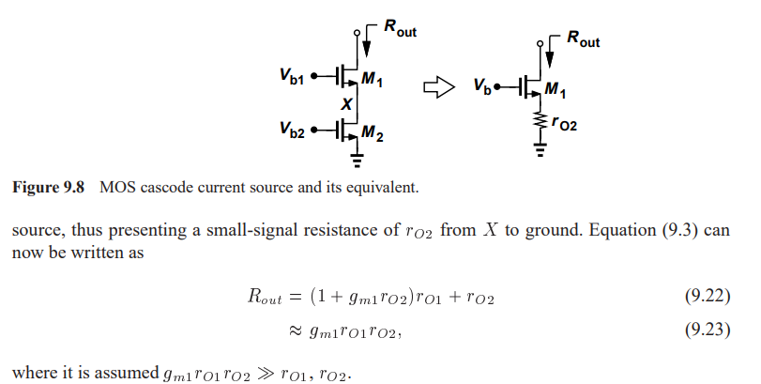
Cascode Differential Pair
Going back to Chapter 9 to under Cascode Amplifier
But why do we need to cascade ?

Slide 3
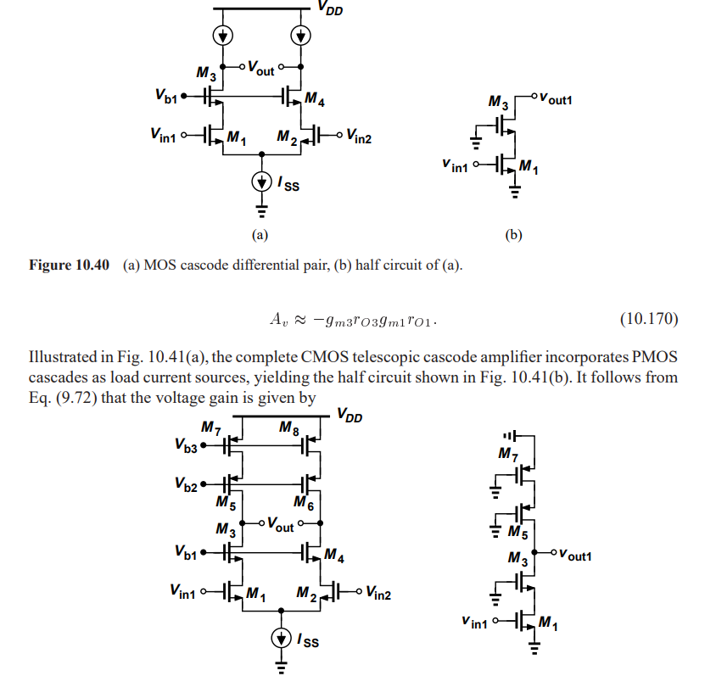

Slide 4
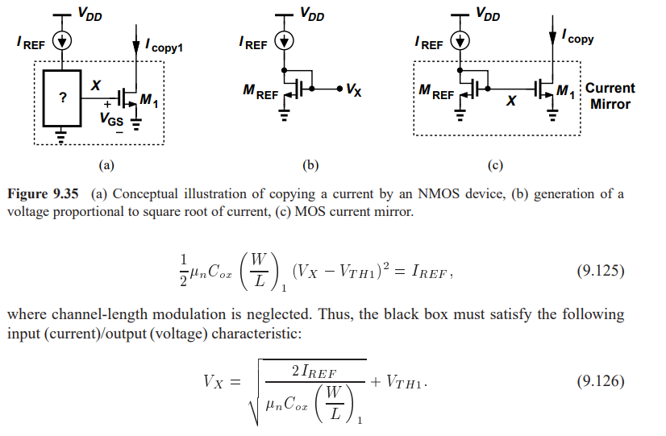
How to achieve current biasing

Slide 5
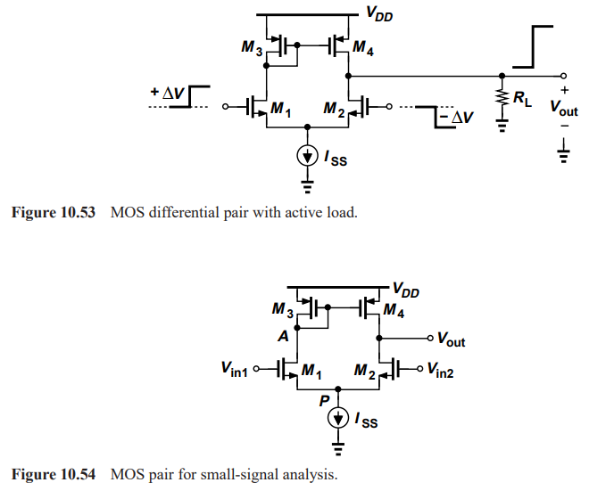
MOS Differential Pair with Active Load

Slide 6
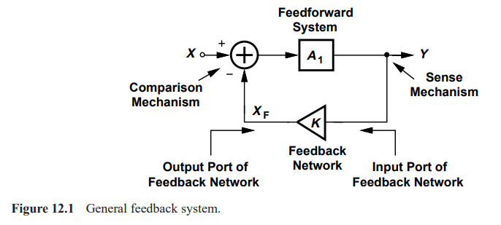
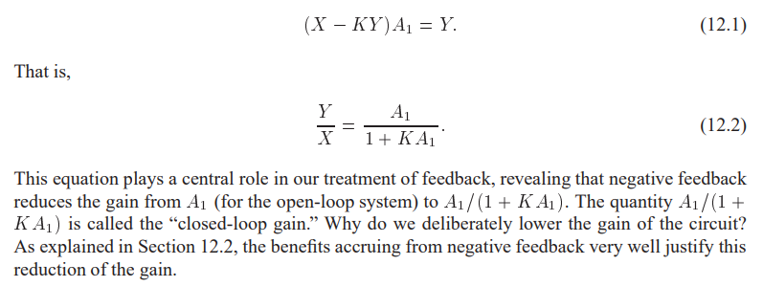
Chapter 12 Feedback , skipping Chapter 11
If K=0, Open Loop System otherwise Closed Loop System

Slide 7
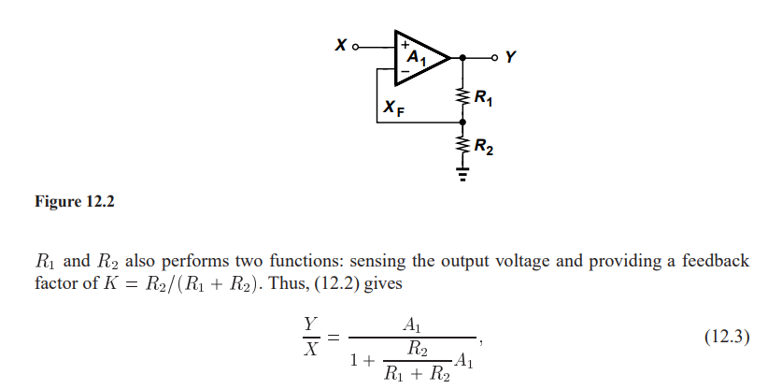

Slide 8
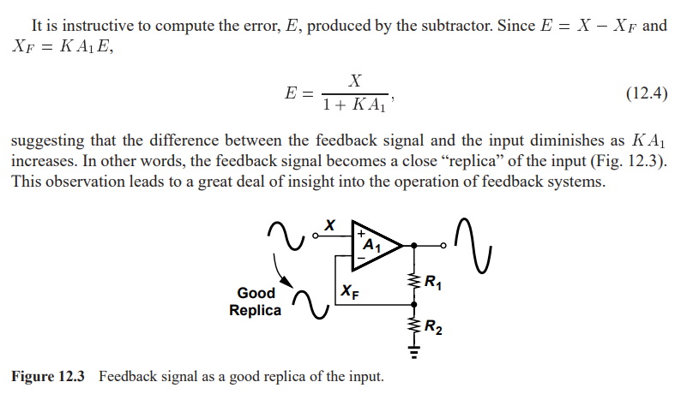

Slide 9
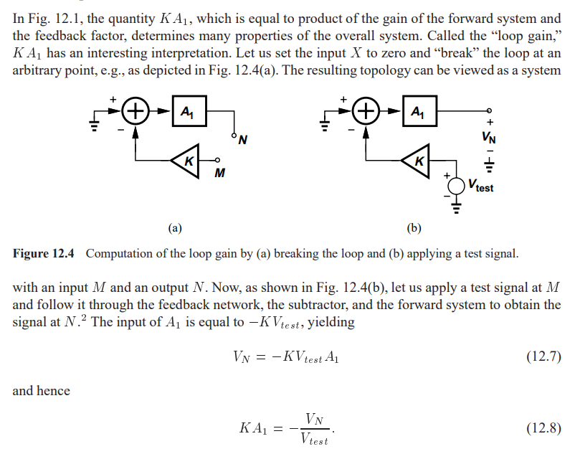
Loop Gain

Slide 10
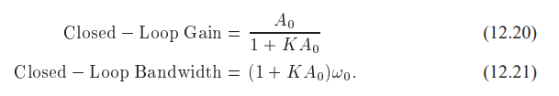
Properties of Negative Feedback
Gain Desensitization
Y/X = 1/K
Bandwidth Extension
Input and Output Impedance
Output impedance decreases

Slide 11
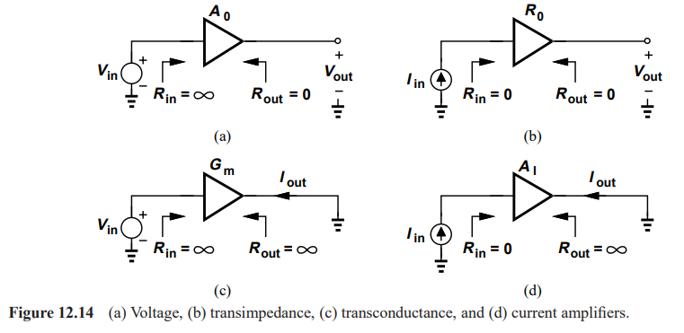
Types of Amplifiers

Slide 12
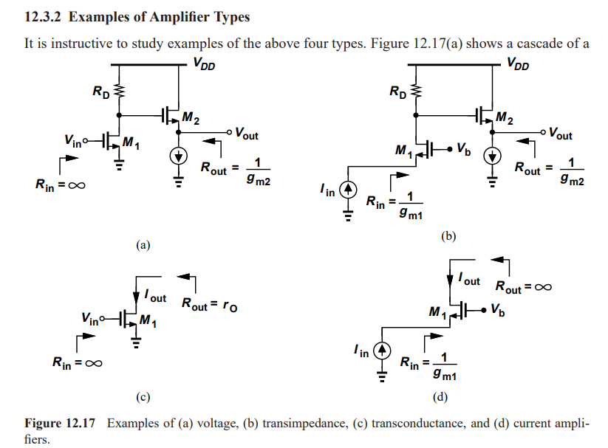

Slide 13
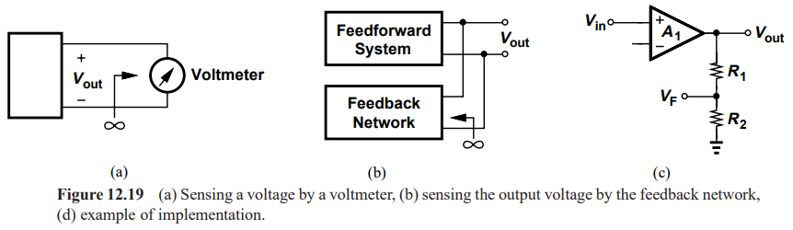
Sense and Return Techniques

Slide 14
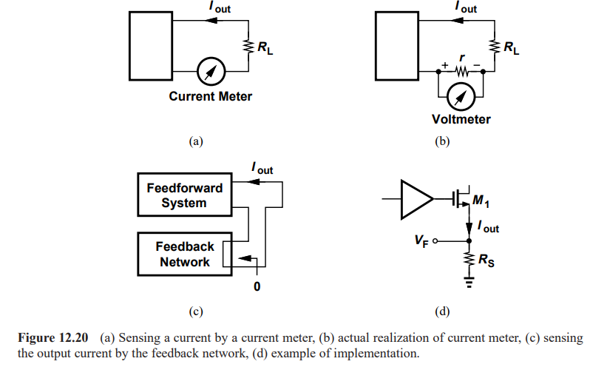

Slide 15
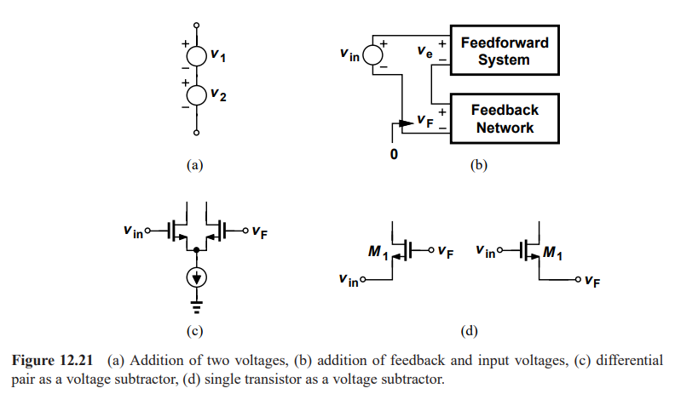

Slide 16
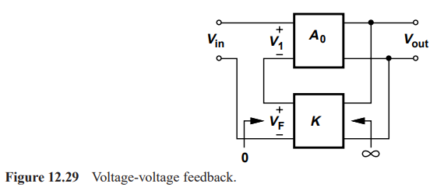
Feedback Topologies

Slide 17
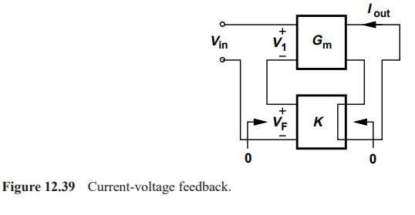

Slide 18
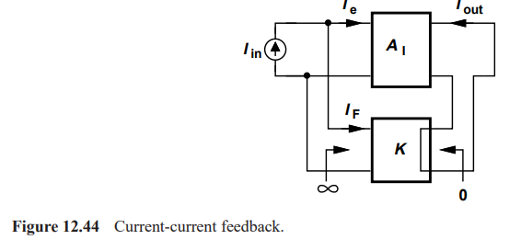

Slide 19
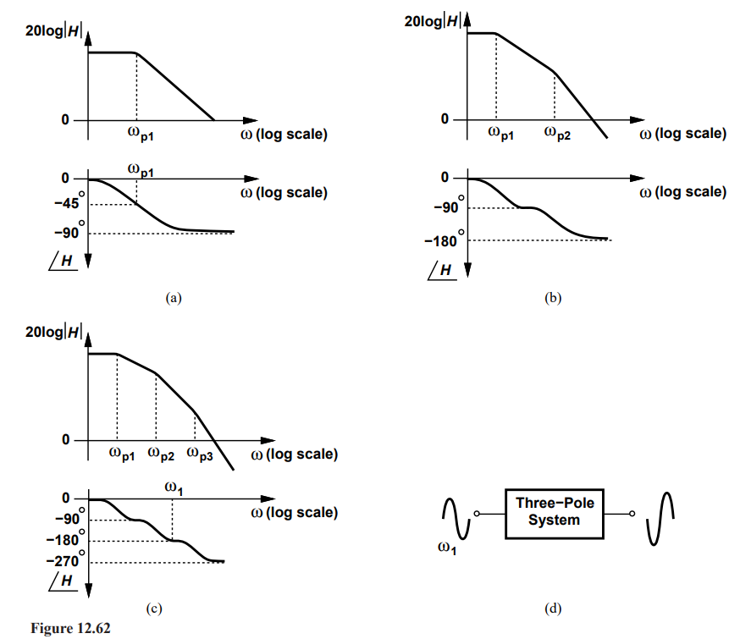

Stability in Feedback System

